Slide 1
Cryptocurrency as a payment option
Presenter: Bence Tureczki
1/20

Slide 2
Why should you pay attention?
You can:
  Pay with cryptocurrencies
    24/7
    Global
    Low-fee (?)
    Quick (?)
    Anonim (?)
2/20

Slide 3
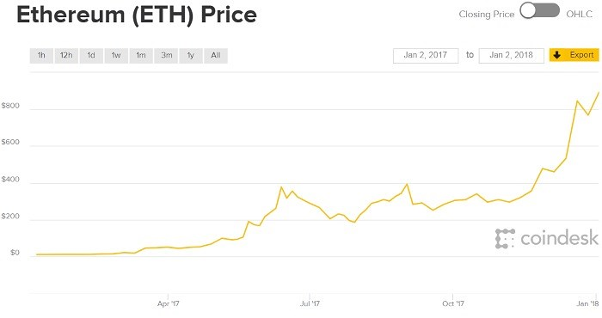
  Buy cryptocurrencies
3/20

Slide 4



  Store cryptocurrencies
4/20

Slide 5
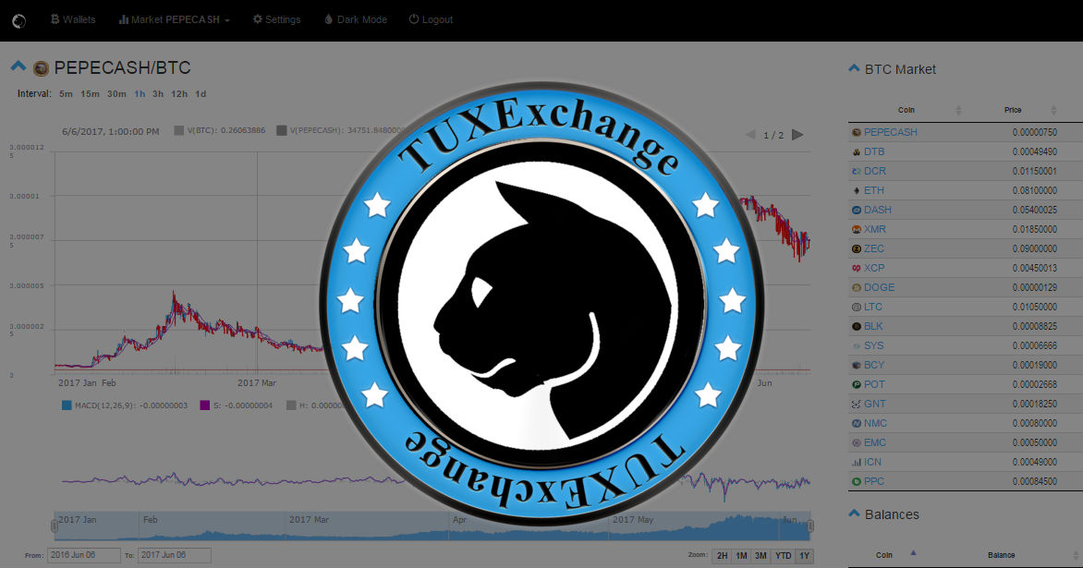
Who am I to talk the talk?
5/20

Slide 6
Topics of this presentation
1) What are cryptocurrencies?
2) How to pay with them?
3) How to buy them?
4) How to store them?
5) Security tips
6) Round-table
6/20

Slide 7
1) What are cryptocurrencies?
1.1) Cryptocurrency network
1.2) Wallet applications
1.3) (Additional) Service providers
7/20

Slide 8
1.1) Cryptocurrency network
Miners
  „Workers”
Nodes
  Databases
    Blocks
      Transactions
      Hash
      Timestamp
8/20

Slide 9
1.2) Wallet applications
„Wallet as a service”
  Discussed under „Service providers”
Desktop wallets
Paper wallets
Hardware wallets
Crystal wallets
Augmented wallets
… and so on!
9/20

Slide 10
Desktop wallets
  Core
  Third-party
      Single
      Multi
10/20

Slide 11
Paper wallets
  Full
  Partial
11/20

Slide 12
1.3) Service providers
  „Wallet as a service”/ Online wallets
  Cryptocurrency exchanges
  Any online market that adapted cryptocurrency as a payment option
12/20

Slide 13
2) How to pay with cryptocurrencies?
2.1) Steps of paying
2.2) Confirmations
2.3) Fee
13/20

Slide 14
Steps of paying
  1. Get a wallet application (Crystal and paper won’t do ☺)
  2. Set the cryptocurrency recipient’s
  public key as address
  3. Select amount and fee (!!)
  4. Send
14/20

Slide 15
Confirmations
  Important:
  Agreement
  Speed of miners
  Number of nodes
15/20

Slide 16
Fee
  Faster confirmation: More fee
  Slower confirmation: Less fee
  Too small fee = „stuck transaction”
16/20

Slide 17
3) How to buy cryptocurrencies?
Buy cryptocurrencies for cryptocurrencies
  Anonim as long as you do not share your personal data!
Buy cryptocurrencies for fiat currencies (USD, HUF…etc.)
    Never anonim!
17/20

Slide 18
4) How to store cryptocurrencies?
Cold storage
No (direct) internet access!
Hot storage
Anything that has internet access!
18/20

Slide 19
5) Security tips
  Keep your private key a secret!
  Generate a new address for each transaction!
  Use additional service providers only as long as you need them!
  Use an escrow when dealing with entities who you do not trust!
  Split your revenue into different types of wallets!
  Have a backup from your private keys in different locations than your original!
19/20

Slide 20
Thank you for attention!
ROUND-TABLE
20/20

