Slide 1
Cloud as a Certificate
What is Interesting in the CCSP certification?

Slide 2
INtroduction
György Kollár
Electrical Engineer, (Old School Informatics)
Small Business Owner
Technical Director since 1991
Early Adopter type
Working in Security in the last 13 years
CISSP (2005-), CCSP (2016-)
Collecting old HP calculators

Slide 3
About the Cloud
Everybody uses it
It costs nothing
Soneone takes care of everything
It will always be there
IT IS SAFE!

Slide 4
About CCSP
Joint certification of (ISC)² and CSA (Cloud Security Alliance)
„A CCSP applies information security expertise to a cloud computing environment and demonstrates competence in cloud security architecture, design, operations, and service orchestration.”
Successful candidates are competent in the following 6 domains

Slide 5
six domains of Common Body of Knowledge (CBK)
Architectural Concepts and Design Requirements
Cloud Data Security
Cloud Platform and Infrastructure Security
Cloud Application Security
Operations
Legal and Compliance

Slide 6
Experience Requirements
Minimum of 5 years experience
Or
CISSP credential

Slide 7
Examination
Length of exam | 4 hours
Number of questions | 125
Question format | Multiple choice
Passing grade | 700 out of 1000 points
Exam availability | English
Testing center | Pearson VUE Testing Center

Slide 8
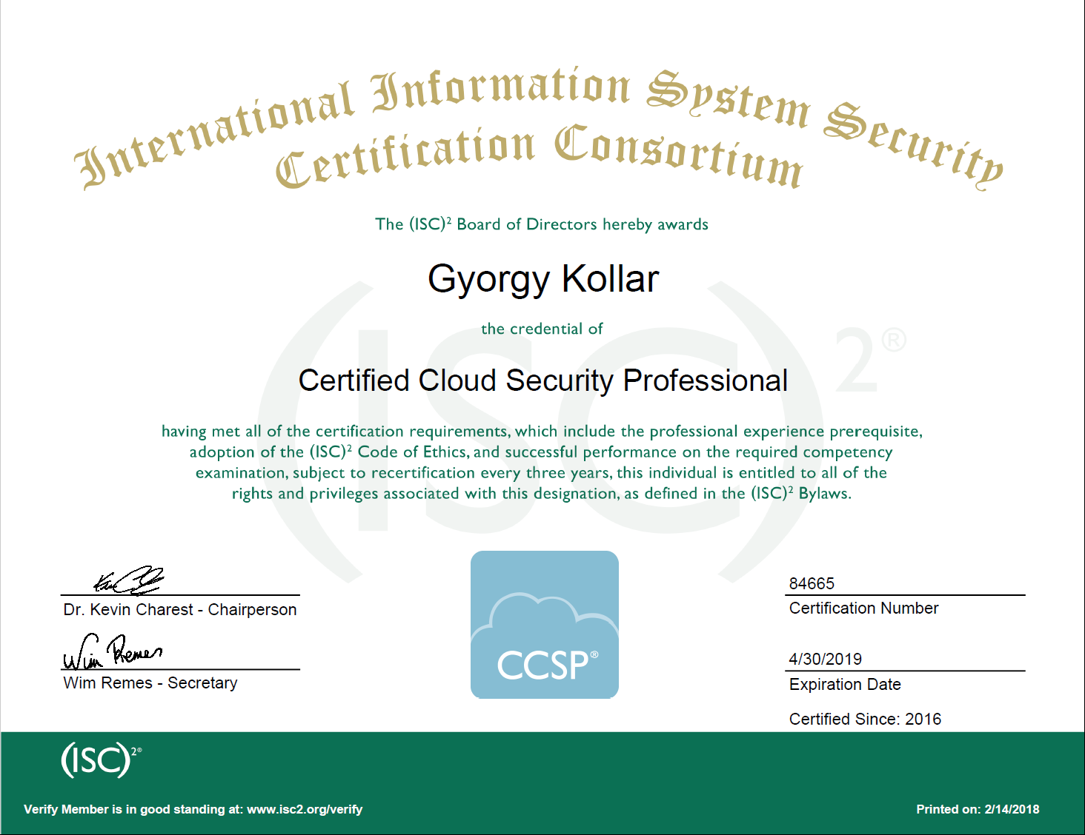

Slide 9
Domain 1: Architectural Concepts and Design Requirements
Cloud Computing Concepts
Cloud Reference Architecture
Security Concepts Relevant to Cloud Computing
Design Principles of Secure Cloud Computing
Trusted Cloud Services

Slide 10

meaning of cloud
on-demand self-service,
broad network access,
resource pooling,
rapid elasticity or expansion,
measured service

Slide 11
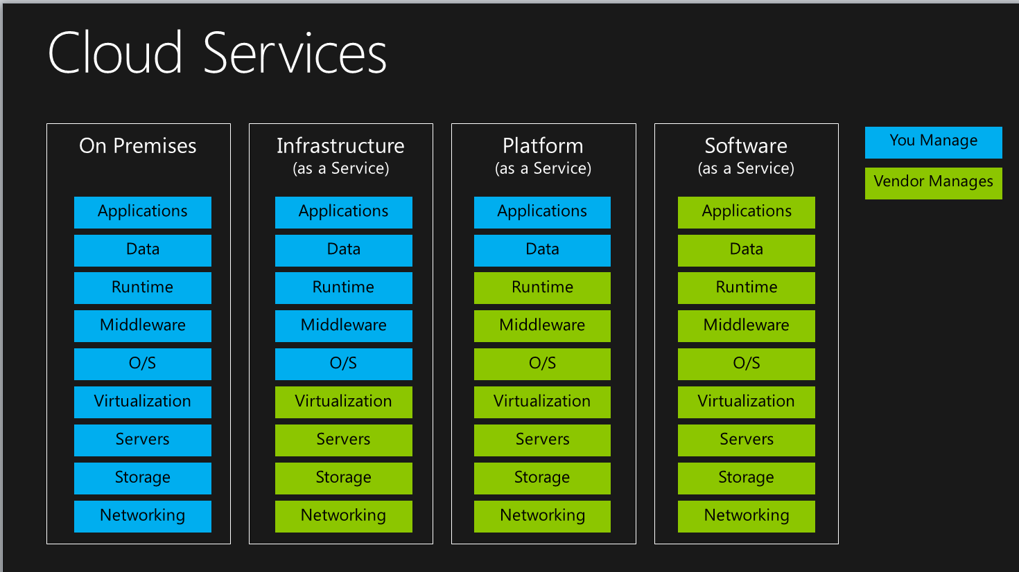
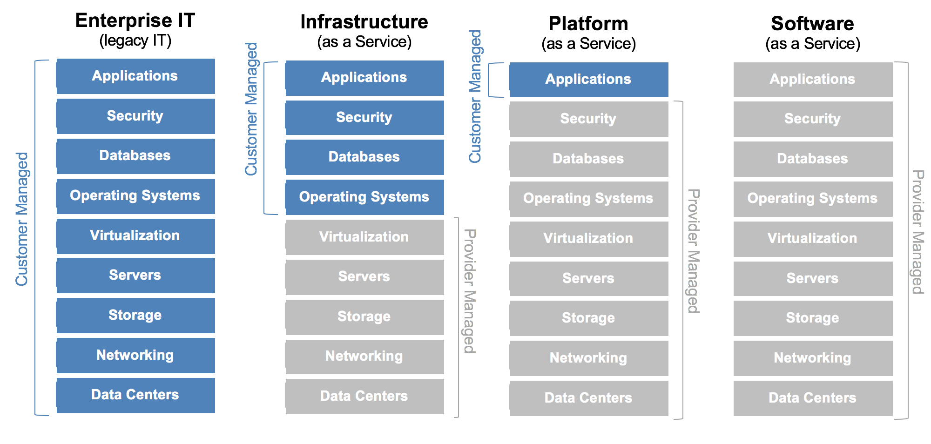
"service models"
Software,
Platform,
Infrastructure

Slide 12
"deployment models"
Private,
Public,
Community,
Hybrid

Slide 13
Domain 2: Cloud Data Security
Cloud Data Lifecycle
Cloud Data Storage Architectures
Data Security Strategies
Data Discovery and Classification
Design and Implement Relevant Jurisdictional Data Protections for Personally Identifiable Information (PII)
Data Rights Management
Data Retention, Deletion, and Archiving Policies
Auditability, Traceability and Accountability of Data Events

Slide 14
Moving to the cloud
CRM
Customer database
Scheduler
Financial data
Project management
Subcontractors
Time management
Calculations
Design documents
Schematics
Mechanical drawings
Software
Network diagrams
Bookkeeping
Tax forms
Invoices

Slide 15
Changes in the Cloud
Where is my data?
Where is my backup?
How can I use my systems?
How can I secure my systems?
How can I delete my data?

Slide 16

Risks shifted and changed
Assets
Who owns the asset?
Who is responsible for the asset?
What asset?

Slide 17
"service models"
Software,
Platform,
Infrastructure

Slide 18
Domain 3: Cloud Platform and Infrastructure Security
Cloud Infrastructure Components
Risks Associated to Cloud Infrastructure
Design and Plan Security Controls
Plan Disaster Recovery and Business Continuity Management

Slide 19
Layered Security
Phisical Layer
Cabling
Services
Power
HVAC
Emergency

Slide 20
Domain 4: Cloud Application Security
Training and Awareness
Cloud Software Assurance and Validation
Use Verified Secure Software
Software Development Life-Cycle (SDLC) Process
Apply the Secure Software Development Life-Cycle the Specifics of Cloud Application Architecture
Identity and Access Management

Slide 21
Domain 5: Operations
Support the Planning Process for the Data Center Design
Implement and Build/ Run / Manage Physical Infrastructure for Cloud Environment
Build/ Run / Manage Logical Infrastructure for Cloud Environment
Ensure Compliance with Regulations and Controls
Conduct Risk Assesment to Logical and Physical Infrastructure
Understand the Collection, Acquisition and Preservation of Digital Evidence
Manage Communication with Relevant Parties

Slide 22
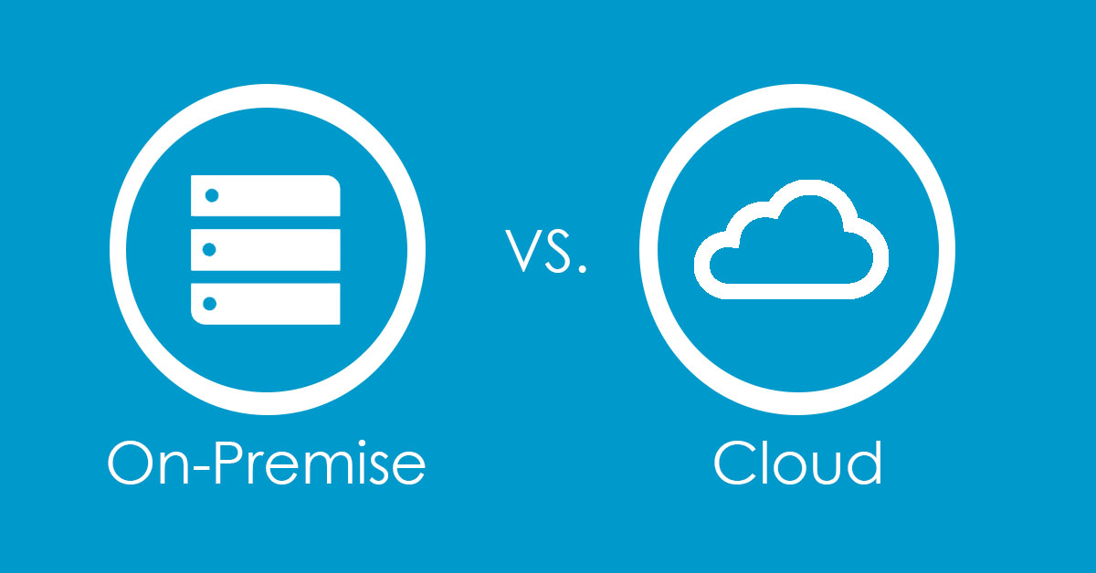
differences between classic and cloud environments
Size matters
Redundancy needs at least two of everything
Cost matters
If you can share resources you can share costs
Location matters
You want to reach it from anywhere, don’t you?

Slide 23
Domain 6: Legal and Compliance
Legal Requirements and Unique Risks within the Cloud Environment
Privacy Issues, Including Jurisdictional Variation
Audit Process, Methodologies, and Required Adaptations for a Cloud Environment
Implications of Cloud to Enterprise Risk Management
Outsourcing and Cloud Contract Design
Vendor Management

Slide 24
GDPR and other regulations
Location
Local Law
Customer Country Law
Etc.

Slide 25
Responsibilities
You can outsoure everything but responsibility
But…
You can buy services
Make contracts
Share risks
If you want something to be done put it into the contract

Slide 26
Costs and benefits
Efficiency
Reliability
Security
Vendor lock-in
Service drift

Slide 27
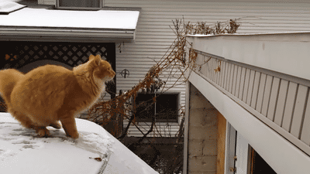
Most overlooked things
Backup (and restore!)
Upgrades
Patch management
Vulnerability management
Confidentiality
Privacy

Slide 28
Cloud guide
Security is not something for free
It will not be included if you do not ask for it
Checking everything is a must
Read the small text as well
Encryption is necessary
Keep a clear way out

Slide 29
Conclusion
Cloud is the next big thing
This knowledge is on high demand
There are lots of opportunities
Cloud security is extremly inextricable (impossible to disentangle or separate.)
References: www.isc2.org/ccsp-cbk-references

Slide 30

John Cleese on Stupidity

Slide 31
Questions
Thank you!

